Slide 1
Dual Credit
Presented by
Special Admissions Coordinator
Sara Sengelmann
Notes:
Hello and welcome. Thank you for coming today.
Happy to see all of you here to learn more about the dual credit program at Collin College
Introduce myself
I am going to cover a lot of material tonight.
After this presentation you will have a better understanding of what dual credit is, the options available to you at Allen HS, and the steps you need to take at Collin to enroll in the program.
If you would, please save any questions until the end of the presentation. I will open it up to questions for the good of the group and then I will be around to answer any specific individual questions you may have.

Slide 2
What is Dual Credit?
A college course that can be used to simultaneously earn high school and COLLEGE credit in one class!
Notes:
Doesn’t that sound great?
Opportunity to get a jump start on college while you are still in high school!
We want you to be college ready – academically and socially
Courses are rigorous and follow college curriculum, taught by Collin professors
This is the perfect way to get your feet wet and
experience the expectations of a college course while still in HS.
Grades will follow you – transcript-official document
Save time and money and potentially earn up to a year or more of college credit before graduating high school.

Slide 3
Benefits of Being a Collin College Dual Credit Student
Courses count toward high school credit
Small class sizes
Educational support from Collin College instructors and support services
Begin a college transcript
Experience college rigor and environment
Time to degree completion
Cost savings

Slide 4
How Much You Will Save!
University of Texas at Dallas
$2,857 for a 3 credit hour course*
University of North Texas
$1,408.44 for a 3 credit hour course*
*Based on Fall 2021 tuition rates
Collin College
is $186
3 credit hour course (for in-county residents)
Based on Fall 2022 tuition rates

Slide 5
Dual Credit Courses are Transferable to Most Public Four-Year Colleges and Universities in Texas
*Students are responsible for determining if transfer institution will accept their credits*

Slide 6
Is Dual Credit Right for You...
The importance of attendance and time management
College professors may deduct points for tardiness or absences
Student code of conduct
Students are expected to behave in a respectful manner. Plagiarism will result in disciplinary action.
Maturity for subject matter and college classroom environment
Professors are entitled to academic freedoms.
Drop/Withdraw deadlines
Did you take on too much?
Get to know your course syllabus and instructor
Best College Tip!
Notes:
Professors can set their own attendance policies, some deduct points after so many absences
Keep up with requirements in syllabus – readings, assignments, due dates, grading policy-use a planner!
Time mgmt – spend 2-3 hours outside of class reading and studying for every hour you are in class
Be sure to find the right balance between your HS/college course load and extracurricular activities (band, athletics, cheerleading, etc.)
We can talk in generalities to parents about the process for enrollment, but nothing specific about the student’s records at Collin
Students are now adults in our eyes, opportunity for them to learn the college going process and take on new responsibilities

Slide 7
Similar to HIPAA law
Federal law that ensures privacy of student educational records
(begins when student starts college regardless of age)
Collin College cannot share grades, course schedules, test scores, etc. with parents
A great opportunity for students to learn the college process and take on new responsibilities
Students will need to use their Collin email address for communication with instructors
* Waiver is available via CougarWeb
Notes:
We can talk in generalities to parents about the process for enrollment, but nothing specific about the student’s records at Collin
Students are now adults in our eyes, opportunity for them to learn the college going process and take on new responsibilities

Slide 8
Dual Credit Eligibility
Students complete the entire Collin College admissions process
Permission must be obtained from high school/homeschool counselor before enrollment
Must meet college readiness standards as defined by Texas Success Initiative (TSI) or provide an exemption.
Student must meet both high school and Collin College academic requirements to continue in the dual credit program.
Notes:
Remember this is a college course, follow same process as any college student plus permission from your school each semester
C or better to maintain participation in the program, you are beginning a college transcript
Grades earned become part of permanent academic record

Slide 9
Course Selection
Courses are meant to supplement your home school curriculum, not replace it. Home School Administrator determines the courses needed for the student to complete their high school diploma. Collin College does not award High School diplomas.
Dual/concurrent credit students are not eligible for kinesiology (KINE) or (Dev Ed) classes.
Select courses that meet home school graduation requirements, Core Curriculum, or courses that are applicable to a desired degree or certificate.
Notes:
Must meet prerequisite and placement requirements as outlined in the college catalog.
Average course load for home school students run from 2-3 courses per semester

Slide 10
Course Descriptions
See the college catalog for placement and prerequisite information:
www.collin.edu/academics/catalog.html
For additional advising help please make an appointment with your special admissions coordinator.

Slide 11
Dual Credit Enrollment Process
APPLY for admission (www.goapplytexas.org)
Remove all holds
Register for your classes
Pay for your classes

Slide 12
Application for Admissions
You may apply online NOW for Fall 2022!
Complete application at www.goapplytexas.org
*Application must be PROCESSED before your next steps*
Notes:
Free, 20 minutes, no essay
Apply early so you will be ready when registration opens

Slide 13
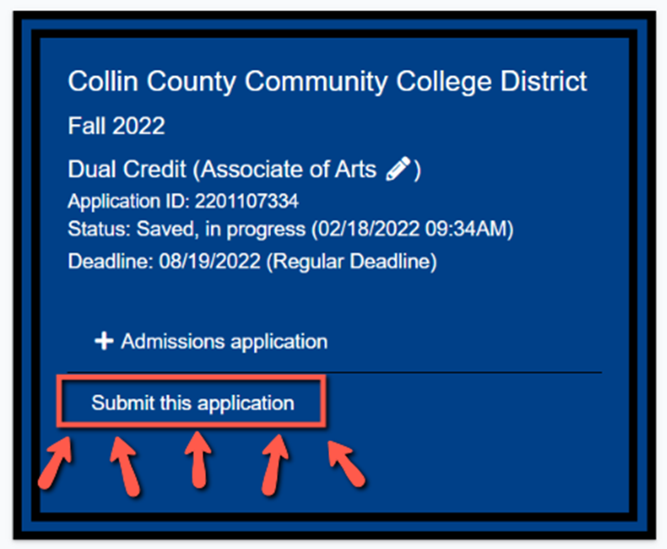
Application Tips
Create an ApplyTexas profile (please use student’s personal email)
Residency/tuition is decided based on your answers on the application and the documentation you provide, if requested
Select Start/Edit Applications
Start a new application
Select “Two Year Community College”
Select “Collin County Community College District”
Select Application Type “Dual Credit”
Select any major
Select +Admissions Application
Answer the dual credit questions and questions specific to Collin.
Select “Submit this application”
Student will receive his/her Collin ID number (CWID), email address, CougarWeb username and password in 3-5 business days
Questions? Please contact a Special Admissions Counselor or the Dual Credit Office

Slide 14
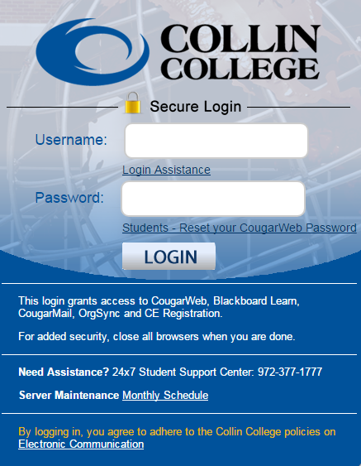
What is CougarWeb?
Students will receive CougarWeb login 3-5 business days AFTER application has been submitted.
CougarWeb is an online portal that includes all of the information and access to services that students need, while attending Collin College.
Add/Drop class
Online trainings
Collin Email
Pay your tuition
Access online courses (Canvas)
Check Collin College class schedule
Grades
And MUCH MORE…

Slide 15
2. Remove All Holds
Holds Resolution Guide

Slide 16
What is a HOLD?
Each admissions step is listed as a hold, so all steps must be completed prior to registration.
A hold prevents registration.
Notes:
If parents/students have checklist refer to it here.

Slide 17
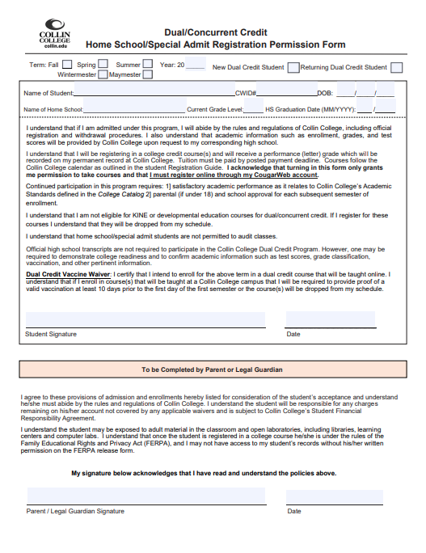
High School Permission Form (Front Page)
✓
22
✓
Smith, Jasmine
100555555
01
01
2008
YOUR HS HERE
11
06 2024
Students must have completed the online application and obtain their CWID BEFORE they can submit this form to their Special Admissions Coordinator, or the Dual Credit office.
This form MUST be completed every semester.
Student Signature
xx/xx/xxxx
Parent/Guardian Signature
xx/xx/xxxx
Notes:
Don’t forget the parent signature if they are under 18 years of age!

Slide 18
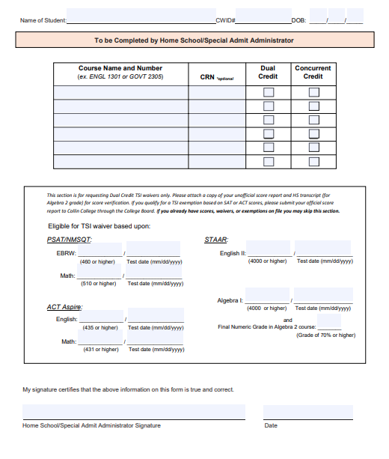
Smith, Jasmine
01
100555555
01
2008
High School Permission Form (Back Page)
ENGL 1301
#####
✓
GOVT 2305
#####
✓
PSYC 2301
#####
✓
It will need to be completed and signed by your Homeschool/High School Counselor or Administrator.
Students must indicate what courses they would like to take for dual credit.
A form is required for all dual/non-dual credit courses.
4000
04/14/2019
4000
04/14/2017
Home School/Administrator Signature
xx/xx/xxxx
Notes:
Don’t forget the parent signature if they are under 18 years of age!

Slide 19
High School Permission Form
✓
Don’t Forget To Register Online through CougarWeb For Your Class!
✓
22
Smith, Jasmine
01
100555555
01
2008
YOUR HS HERE
11
06 2024
Summer Registration opens March 7th
Fall registration opens April 12th
Spring Registration opens in late October.
Students must register themselves every semester through CougarWeb. If you have questions reach out to your Special Admissions Coordinator or the Dual Credit office.
Student Signature
xx/xx/xxxx
Parent/Guardian Signature
xx/xx/xxxx
Notes:
Don’t forget the parent signature if they are under 18 years of age!

Slide 20
Texas Success Initiative (TSI)
The TSI is designed to measure college readiness in reading, writing, and mathematics.
It is used for course placement purposes.
Students must be at college level in ELAR for the majority of courses.
See the college catalog for placement and prerequisite information: https://www.collin.edu/academics/catalog.aspx
Notes:
TSI-Texas Success Initiative
You must be assessed in reading, writing, and math or prove an exemption or waiver

Slide 21
TSI Exemptions
Exemption Scores (minimum scores listed)
Test | Combined/Composite Requirement | Exempts TSI Reading & Writing | Exempts TSI Math
SAT (3/2016 and After) | NO Combined/Composite Score Needed | Evidence Based Reading/Writing 480 | Math: 530
ACT | Composite: 23 | English: 19 | Math: 19
Partial exemptions allowed provided that the required combined/composite score is met.
For more information on exemptions, please review the
Collin College New Student Checklist or visit www.collin.edu/express/dualcredit.
Notes:
Here are a couple of ways you can be exempt from needing the assessment
You just have to have one of these-not all, can be partially exempt, can mix and match, must have composite/combined to use ACT or SAT
We will need proof of your scores-could be on your transcript or sent directly from the testing source

Slide 22
Official Scores Needed
Contact College Board or ACT student website and have them send your official score report directly to Collin College.
It takes approximately 11-12 business days for Collin College to receive and process them.
ACT Collin Code: 4046 SAT Collin Code: 1951

Slide 23
TSI Waivers
Temporary Waivers for Dual Credit Students (minimum scores listed)
Test | Combined/Composite Requirement | Waives TSI Reading and Writing | Waives TSI Math
ACT-Aspire | N/A | English: 435 | Math: 431
PSAT (After Oct. 2015) | N/A | Evidenced Based Reading/Writing: 460 | Math: 510
STAAR | N/A | English II: 4000 | Algebra I: 4000 and at least a final grade of 70% in Algebra 2

Slide 24
TSI Waivers
Scores must be reported on the HS permission form by the home school administrator. Please provide an attached copy of an unofficial score report and HS transcript (for Algebra 2 grade) for score verification.
For more information on waivers, please review the Collin College New Student Checklist or visit www.collin.edu/express/dualcredit.

Slide 25
TSI: What Will I Need to Do?
Complete Pre-Assessment Activity (PAA) and print the certificate of completion.
Review email from assessments@Collin.edu regarding testing procedures.
Pay at the cashier’s office or online. The cost is $29.
In-Person testing is available at any campus Testing Center by Appointment.
Online testing is offered through a virtual testing platform. The current cost is $40.
Visit our TSI Testing webpage on Collin’s website for more details.
Notes:
Online Testing is available now, please visit the TSI website at Collin.edu.

Slide 26
What if my TSI scores are low?
The purpose of this assessment is to find out what level you should start your coursework.
You only need college level placement in the areas needed for your course (e.g. ENGL 1301 requires college level in reading and writing but not in math).
Mandatory Advising (MA) hold
Will be on your account if you place below college level in at least one area, must see Special Admissions Coordinator (no appt needed) before you can register online.
If you do not place at “college level” in the areas required for your course that means you need to focus on your high school work at this time.
Notes:
Remember you can’t study for it, it assesses what you should have already learned
You can always retest-whole or portion-whatever you need! Have to pay $29 each time.
We know tests don’t measure everything but this is all we have to assess where you are
May need to focus on HS work

Slide 27
Bacterial Meningitis Vaccination
Dual Credit students taking classes at any Collin campus MUST provide proof of an having vaccination within 5 years, documentation of an exemption if they under the age of 22. The vaccination must be administered at least 10 days prior to start of entering term..
Dual Credit students taking classes online or at their home school campus may request for an exemption by completing, signing, and turning in a Dual Credit Registration Permission form.
For more information, please visit
www.collin.edu/meningitis
Notes:
This is a state law
If you will be taking courses on a HS campus, you can fill out the purple request for exception form in your packet to exempt you from needing the vaccine, turn in to Admissions and Records prior to registration
Remember if you ever take a course on a Collin campus you will need the vaccination

Slide 28
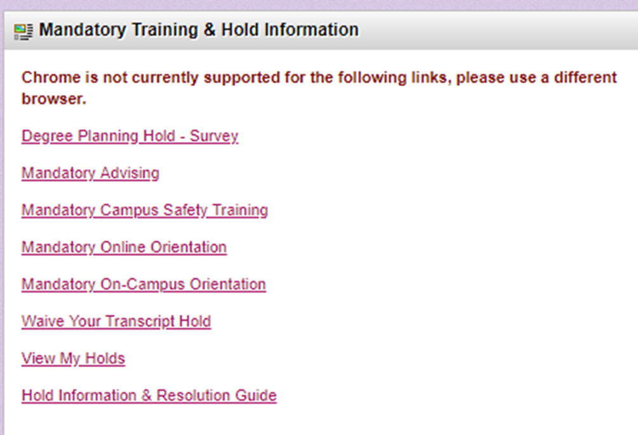
Mandatory Campus Safety Training
Students will be required to complete training prior to registration via CougarWeb
How to Access Training
Log into CougarWeb account
Go to the Student Tab
Click Mandatory Campus Safety Training
Complete quiz with a 100% score and be sure to click submit at the end
Notes:
Turn in your packets to counselor
Use Look Up Classes to enroll in general population courses on a Collin College campus
Use Add or Drop Classes to enroll in classes on a high school/co-op campus
enter the specific course reference number (CRN)
Be sure to select spring 2016 Credit term
Detailed instructions with dates can be found on your course schedule sheet

Slide 29
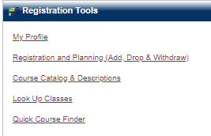
How Do I Check for HOLDS on My Account?
Instructions
Log into your CougarWeb account
Click on My Profile under the “Home Tab” right side of the page.
Click on “Holds” upper right side.

Slide 30
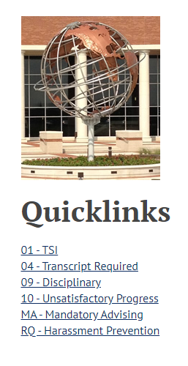
Hold Resolution Guide
Need Assistance with Holds?
Use our Hold Resolution Guide to take care of the following holds:
HS Permission Form
SSN/ITIN/WS9 Required
Immunization Proof Required
TSI Assessment
And others!

Slide 31
3. Ready to Register

Slide 32
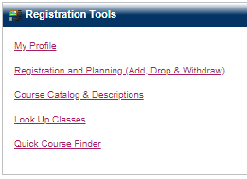
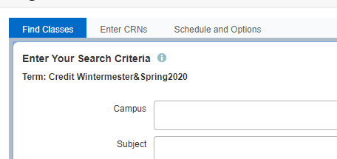
Registration Instructions
For Dual Credit Classes at High School/College Campus
Log into CougarWeb
Go to Registration and Planning
Click on Add, Drop, or Withdraw
Enter Credit Fall 2022 term
Click on Enter CRNs tab
Enter the specific CRN for your designated course
Click Add to Summary
Click Submit
Notes:
Turn in your packets to counselor
Use Look Up Classes to enroll in general population courses on a Collin College campus
Use Add or Drop Classes to enroll in classes on a high school/co-op campus
enter the specific course reference number (CRN)
Be sure to select spring 2016 Credit term
Detailed instructions with dates can be found on your course schedule sheet

Slide 33
Tuition
$60 per credit hour for students residing in Collin County
= $186 for a 3 credit hour course (including $2 activity fee)
$115 per credit hour for students residing out-of-county = $351 for a 3 credit hour course
Total cost per 3 credit hour course includes a $2 per credit hour student activity fee.
*All fees are subject to change upon approval of the Collin Board of Trustees*
Based on Fall 2022 tuition rates
Tuition is paid per semester.

Slide 34
Payment Instructions
Log into CougarWeb account
Under Student Quick Links
Click on CougarPay
Click the Collin College Account Suite button
Then click on Make a Payment
Parents can sign up to be an authorized user, so they receive payment emails from the business office.

Slide 36
Dual Credit Website
Home Page
Student Page
Access to forms and FAQs
Links to dedicated pages for students, parents, and counselors
Important dates and deadlines
Dual Credit benefits
Eligibility and enrollment tips
Application and registration resources
Link to school specific pages
Notes:
Click image to access homepage.

Slide 37
What Does ACCESS Do?
Provides equal access to the educational opportunities and services for students with disabilities through academic accommodations for those who qualify

Slide 38
To Receive Accommodations
A student must:
Self-identify
Apply for services directly through the Collin College ACCESS office
Provide documentation of his/her disability
Request accommodations each semester for each professor
Dual Credit ACCESS Advisor: Melissa Parkes at ACCESSDualCredit@Collin.edu

Slide 39
Campus Resources (No additional cost to students)
Career Services
Counseling
Fitness Center
Library
Math Lab
Student Center
Tutoring
Writing Center
TransferU
(transferu.collin.edu)
Notes:
Awareness of resources – both academic and personal
ACCESS (Accommodations at Collin College for Equal Support Services) provides reasonable accommodations for students with documented disabilities. Contact them if you are needing resources such as extra time testing, if you need a note taker/recorder, test reader, etc…. Remember the requirements are different than they are at the high school level and you are responsible for seeking out their services. Please do so as soon as possible so that they have plenty of time to work with you.
Take advantage of tutoring, math lab, writing center
Free, all campuses
Please come to campus even if taking courses only on site at your high school

Slide 40
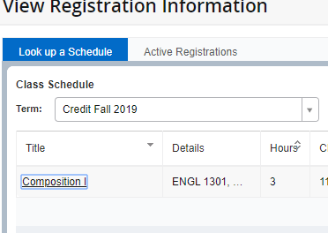
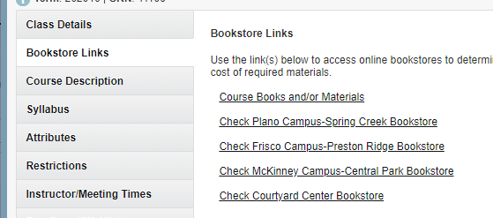
Get Books
You have to buy books in college!
You may purchase books from our on campus bookstore.
There is also a link on your schedule in CougarWeb.
Log into CougarWeb
Click on My Class Schedule under Student Quick Links
Adjust Registration Term to Credit Fall 2022 if needed
Click the Title of course and select Bookstore Links Tab
Select Course Books and/or Materials
Notes:
Be prepared – books can be more expensive than the class
Encourage you to shop around

Slide 41
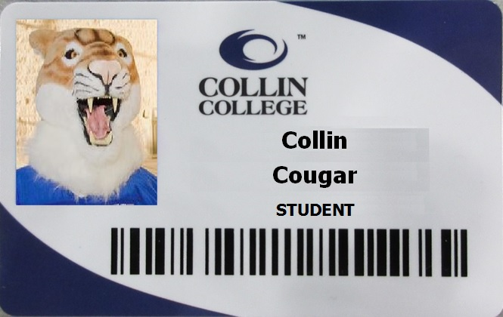
College ID and Parking Sticker
Pick them up from a Student Engagement office on any campus
Both are FREE!
An ID allows you to use campus services
Not a requirement for the first day of class; please pick one up at your convenience.

Slide 42
Summer/Fall 2022 Important Dates
You can apply online at goapplytexas.org now!
Summer Registration opens March 7th
Fall Registration opens April 12th
Summer Payment Deadline is May 4th by 7PM
Fall 2022 Payment Deadline is July 20th by 7PM
Notes:
Pay attention to deadlines, if you don’t pay, you will get put back in HS courses and dropped from college course

Slide 43
Questions?
Dual Credit Office
www.collin.edu/express/dualcredit
469-365-1850
Dualcredit@Collin.Edu
Sara Sengelmann
SESengelmann@Collin.Edu

